Slide 2
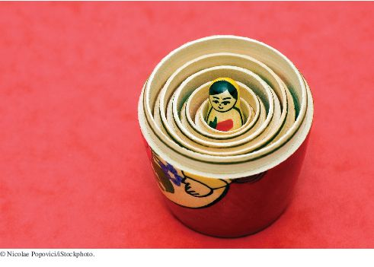
Chapter Goals
To learn to “think recursively”
To be able to use recursive helper methods
To understand the relationship between recursion and iteration
To understand when the use of recursion affects the efficiency of an algorithm
To analyze problems that are much easier to solve by recursion than by iteration
To process data with recursive structures using mutual recursion

Slide 3
Recursion
Recursion is a programming technique in which a method can call itself to fulfill its purpose
A recursive definition is one which uses the word or concept being defined in the definition itself
In some situations, a recursive definition can be an appropriate way to express a concept
Before applying recursion to programming, it is best to practice thinking recursively

Slide 4
Recursive Definitions
Consider the following list of numbers:
24, 88, 40, 37
Such a list can be defined recursively:
A LIST is a: number
or a: number comma LIST
That is, a LIST can be a number, or a number followed by a comma followed by a LIST
The concept of a LIST is used to define itself

Slide 5
Recursive Definitions
_{LIST:} _{number comma LIST}
_{24 , 88, 40, 37}
_{number comma LIST}
_{88 , 40, 37}
_{number comma LIST}
_{40 , 37}
_{number}
₃₇

Slide 6
Infinite Recursion
All recursive definitions must have a non-recursive part
If they don't, there is no way to terminate the recursive path
A definition without a non-recursive part causes infinite recursion
This problem is similar to an infinite loop -- with the definition itself causing the infinite “looping”
The non-recursive part is called the base case

Slide 7
Recursion in Math
Mathematical formulas are often expressed recursively
N!, for any positive integer N, is defined to be the product of all integers between 1 and N inclusive
This definition can be expressed recursively:
1! = 1
N! = N * (N-1)!
A factorial is defined in terms of another factorial until the base case of 1! is reached

Slide 8
Recursive Programming
A method in Java can invoke itself; if set up that way, it is called a recursive method
The code of a recursive method must handle both the base case and the recursive case
Each call sets up a new execution environment, with new parameters and new local variables
As always, when the method completes, control returns to the method that invoked it (which may be another instance of itself)

Slide 9
Recursive Programming
Consider the problem of computing the sum of all the integers between 1 and N, inclusive
If N is 5, the sum is
1 + 2 + 3 + 4 + 5
This problem can be expressed recursively as:
The sum of 1 to N is N plus the sum of 1 to N-1

Slide 10
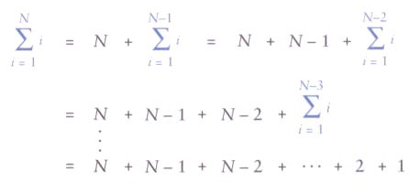
Recursive Programming
The sum of the integers between 1 and N:

Slide 11
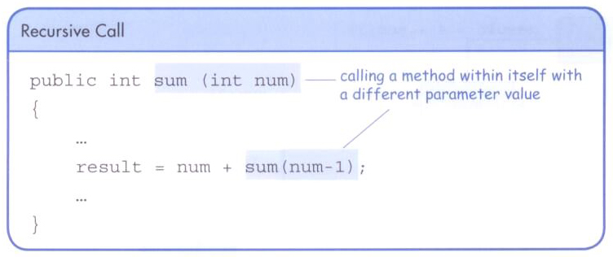
Recursive Programming
A recursive method that computes the sum of 1 to N:
public int sum(int num)
{
int result;
if (num == 1)
result = 1;
else
result = num + sum(num-1);
return result;
}

Slide 12
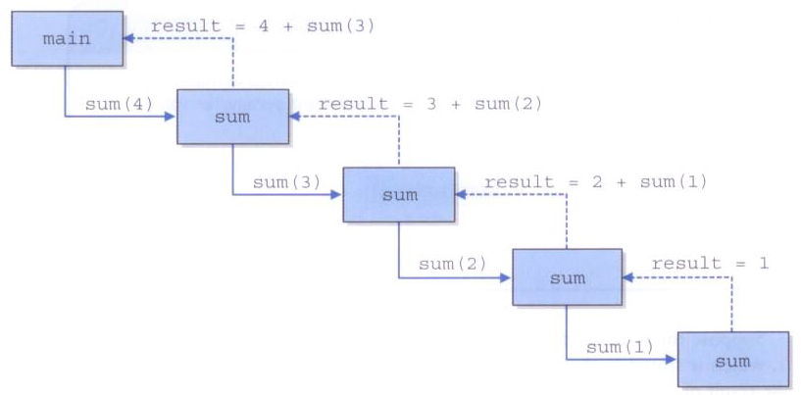
Recursive Programming
Tracing the recursive calls of the sum method

Slide 13
Recursion vs. Iteration
Just because we can use recursion to solve a problem, doesn't mean we should
For instance, we usually would not use recursion to solve the sum of 1 to N
The iterative version is easier to understand (in fact there is a formula that computes it without a loop at all)
You must be able to determine when recursion is the correct technique to use

Slide 14
Recursion vs. Iteration
Every recursive solution has a corresponding iterative solution
A recursive solution may simply be less efficient
Furthermore, recursion has the overhead of multiple method invocations
However, for some problems recursive solutions are often more simple and elegant to express

Slide 15
Direct vs. Indirect Recursion
A method invoking itself is considered to be direct recursion
A method could invoke another method, which invokes another, etc., until eventually the original method is invoked again
For example, method m1 could invoke m2, which invokes m3, which invokes m1 again
This is called indirect recursion
It is often more difficult to trace and debug

Slide 16
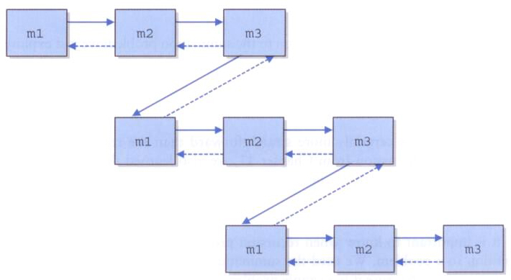
Direct vs. Indirect Recursion

Slide 17
Maze Traversal
We've seen a maze solved using a stack
The same approach can also be done using recursion
The run-time stack tracking method execution performs the same function
As before, we mark a location as "visited" and try to continue along the path
The base cases are:
a blocked path
finding a solution

Slide 18
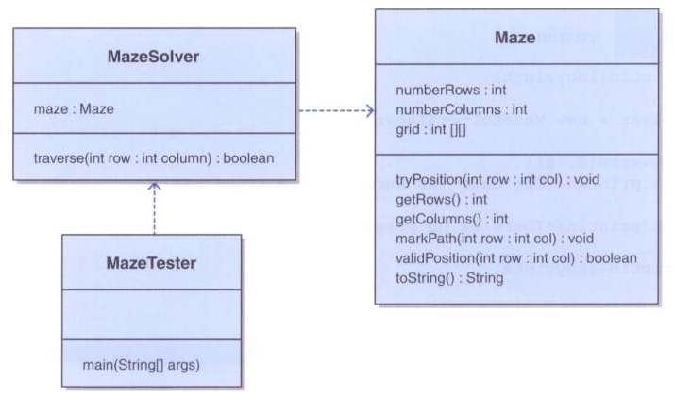
Maze Traversal

Slide 19
import java.util.*;
import java.io.*;
/**
* MazeTester uses recursion to determine if a maze can be traversed.
*
* @author Lewis and Chase
* @version 4.0
*/
public class MazeTester
{
/**
* Creates a new maze, prints its original form, attempts to
* solve it, and prints out its final form.
*/
public static void main(String[] args) throws FileNotFoundException
{
Scanner scan = new Scanner(System.in);
System.out.print("Enter the name of the file containing the maze: ");
String filename = scan.nextLine();
Maze labyrinth = new Maze(filename);
System.out.println(labyrinth);
MazeSolver solver = new MazeSolver(labyrinth);

Slide 20
if (solver.traverse(0, 0))
System.out.println("The maze was successfully traversed!");
else
System.out.println("There is no possible path.");
System.out.println(labyrinth);
}
}

Slide 21
import java.util.*;
import java.io.*;
/**
* Maze represents a maze of characters. The goal is to get from the
* top left corner to the bottom right, following a path of 1's. Arbitrary
* constants are used to represent locations in the maze that have been TRIED
* and that are part of the solution PATH.
*
* @author Lewis and Chase
* @version 4.0
*/
public class Maze
{
private static final int TRIED = 2;
private static final int PATH = 3;
private int numberRows, numberColumns;
private int[][] grid;

Slide 22
/**
* Constructor for the Maze class. Loads a maze from the given file.
* Throws a FileNotFoundException if the given file is not found.
*
* @param filename the name of the file to load
* @throws FileNotFoundException if the given file is not found
*/
public Maze(String filename) throws FileNotFoundException
{
Scanner scan = new Scanner(new File(filename));
numberRows = scan.nextInt();
numberColumns = scan.nextInt();
grid = new int[numberRows][numberColumns];
for (int i = 0; i < numberRows; i++)
for (int j = 0; j < numberColumns; j++)
grid[i][j] = scan.nextInt();
}
/**
* Marks the specified position in the maze as TRIED
*
* @param row the index of the row to try
* @param col the index of the column to try
*/
public void tryPosition(int row, int col)
{
grid[row][col] = TRIED;
}

Slide 23
/**
* Return the number of rows in this maze
*
* @return the number of rows in this maze
*/
public int getRows()
{
return grid.length;
}
/**
* Return the number of columns in this maze
*
* @return the number of columns in this maze
*/
public int getColumns()
{
return grid[0].length;
}
/**
* Marks a given position in the maze as part of the PATH
*
* @param row the index of the row to mark as part of the PATH
* @param col the index of the column to mark as part of the PATH
*/
public void markPath(int row, int col)
{
grid[row][col] = PATH;
}

Slide 24
/**
* Determines if a specific location is valid. A valid location
* is one that is on the grid, is not blocked, and has not been TRIED.
*
* @param row the row to be checked
* @param column the column to be checked
* @return true if the location is valid
*/
public boolean validPosition(int row, int column)
{
boolean result = false;
// check if cell is in the bounds of the matrix
if (row >= 0 && row < grid.length &&
column >= 0 && column < grid[row].length)
// check if cell is not blocked and not previously tried
if (grid[row][column] == 1)
result = true;
return result;
}

Slide 25
/**
* Returns the maze as a string.
*
* @return a string representation of the maze
*/
public String toString()
{
String result = "\n";
for (int row=0; row < grid.length; row++)
{
for (int column=0; column < grid[row].length; column++)
result += grid[row][column] + "";
result += "\n";
}
return result;
}
}

Slide 26
/**
* MazeSolver attempts to recursively traverse a Maze. The goal is to get from the
* given starting position to the bottom right, following a path of 1's. Arbitrary
* constants are used to represent locations in the maze that have been TRIED
* and that are part of the solution PATH.
*
* @author Lewis and Chase
* @version 4.0
*/
public class MazeSolver
{
private Maze maze;
/**
* Constructor for the MazeSolver class.
*/
public MazeSolver(Maze maze)
{
this.maze = maze;
}

Slide 27
/**
* Attempts to recursively traverse the maze. Inserts special
* characters indicating locations that have been TRIED and that
* eventually become part of the solution PATH.
*
* @param row row index of current location
* @param column column index of current location
* @return true if the maze has been solved
*/
public boolean traverse(int row, int column)
{
boolean done = false;
if (maze.validPosition(row, column))
{
maze.tryPosition(row, column); // mark this cell as tried
if (row == maze.getRows()-1 && column == maze.getColumns()-1)
done = true; // the maze is solved
else
{
done = traverse(row+1, column); // down
if (!done)
done = traverse(row, column+1); // right

Slide 28
if (!done)
done = traverse(row-1, column); // up
if (!done)
done = traverse(row, column-1); // left
}
if (done) // this location is part of the final path
maze.markPath(row, column);
}
return done;
}
}

Slide 29
Factorials
Develop a recursive application to compute factorials
Compare to iterative solution
Which is better? Why?

Slide 30
Factorials – Recursive Solution
public static long calcFact(int x) {
if (x==1)
return 1;
else
return x*calcFact(x-1);
}

Slide 31
Factorials – Recursive Method Calls
public static long calcFact(int x) {
System.out.println("calc. factorial of " + x);
if (x==1)
return 1;
else
return x*calcFact(x-1);
}

Slide 32
Factorials – Iterative Solution
Int x=1;
for (int i=1;i<=n;i++)
x=x*i;

Slide 33
Factorials – Which Solution is Better?
import java.util.*;
public class Factorial {
public static long calcFact(int x) {
if (x==1)
return 1;
else
return x*calcFact(x-1);
}
public static void main (String [] args) {
long time1,time2;
Scanner keyboard = new Scanner(System.in);
System.out.println("Enter a positive integer");
int n=keyboard.nextInt();
time1=System.nanoTime();
long x=Factorial.calcFact(n);
System.out.println("the final number is " + x);
time2=System.nanoTime();
System.out.println(n + "!="+x+" took " + (time2-time1) + " nano seconds using recursion");
time1=System.nanoTime();
x=1;
for (int i=1;i<=n;i++)
x=x*i;
System.out.println("the factorial is "+ x);
time2=System.nanoTime();
System.out.println(n + "!="+x+" took " + (time2-time1) + " nanoseconds using iteration");
}
}

Slide 34
Factorials – Time Comparison
Enter a positive integer
4
calc. factorial of 4
calc. factorial of 3
calc. factorial of 2
calc. factorial of 1
the final number is 24
4!=24 took 7613581 nano seconds using recursion
the factorial is 24
4!=24 took 400469 nanoseconds using iteration
Press any key to continue . . .

Slide 35
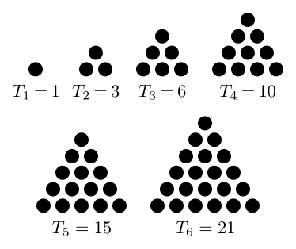
Triangle Numbers
A triangular number or triangle number counts objects arranged in an equilateral triangle, as in the diagram below. The nth triangular number is the number of dots in the triangular arrangement with n dots on a side, and is equal to the sum of the n natural numbers from 1 to n.

Slide 36
Triangle Numbers
Here are the two parts to recursion:
If the problem is easy, solve it immediately.
An easy problem is a base case.
If the problem can't be solved immediately, divide it into smaller problems, then:
Solve the smaller problems by applying this procedure to each of them.
And here is how this applies to triangle numbers:
Triangle( 1 ) = 1
Triangle( N ) = N + Triangle( N-1 )

Slide 37
Triangle Numbers
public int findTriangleNumber(int tnumber) {
if (tnumber == 1) {
return 1;
}
else {
return (tnumber + findTriangleNumber(tnumber - 1));
}
}

Slide 38
Finding the Area of a Triangle
The area of a triangle can also be found recursively.

Slide 39
Outline of Triangle Class
public class Triangle
{
private int width;
public Triangle(int aWidth)
{
width = aWidth;
}
public int getArea()
{
. . .
}
}

Slide 40
Handling Triangle of Width 1
The triangle consists of a single square.
Its area is 1.
Add the code to getArea method for width 1:
public int getArea()
{
if (width == 1) { return 1; }
. . .
}

Slide 41
Handling the General Case
Assume we know the area of the smaller, colored triangle
[]
[][]
[][][]
[][][][]
Area of larger triangle can be calculated as:
smallerArea + width
To get the area of the smaller triangle:
Make a smaller triangle and ask it for its area:
Triangle smallerTriangle = new Triangle(width - 1);
int smallerArea = smallerTriangle.getArea();

Slide 42
Completed getArea Method
public int getArea()
{
if (width == 1) { return 1; }
Triangle smallerTriangle = new Triangle(width - 1);
int smallerArea = smallerTriangle.getArea();
return smallerArea + width;
}
A recursive computation solves a problem by using the solution to the same problem with simpler inputs.

Slide 43
Computing the Area of a Triangle with Width 4
getArea method makes a smaller triangle of width 3
It calls getArea on that triangle
That method makes a smaller triangle of width 2
It calls getArea on that triangle
That method makes a smaller triangle of width 1
It calls getArea on that triangle
That method returns 1
The method returns smallerArea + width = 1 + 2 = 3
The method returns smallerArea + width = 3 + 3 = 6
The method returns smallerArea + width = 6 + 4 = 10

Slide 44
Recursion
A recursive computation solves a problem by using the solution of the same problem with simpler values.
Two requirements for successful recursion.
For recursion to terminate, there must be special cases for the simplest inputs.
To complete our Triangle example, we must handle width <= 0:
if (width <= 0) return 0;
Two key requirements for successful recursion:
Every recursive call must simplify the computation in some way
There must be special cases to handle the simplest computations directly

Slide 45
Other Ways to Compute Triangle Numbers
The area of a triangle equals the sum:
1 + 2 + 3 + . . . + width
Using a simple loop:
double area = 0;
for (int i = 1; i <= width; i++)
area = area + i;
Using math:
1 + 2 + . . . + n = n × (n + 1)/2
=> area = width * (width + 1) / 2

Slide 46
section_1/Triangle.java
1 /**
2 A triangular shape composed of stacked unit squares like this:
3 []
4 [][]
5 [][][]
6 . . .
7 */
8 public class Triangle
9 {
10 private int width;
11
12 /**
13 Constructs a triangular shape.
14 @param aWidth the width (and height) of the triangle
15 */
16 public Triangle(int aWidth)
17 {
18 width = aWidth;
19 }
20
Continued

Slide 47
section_1/Triangle.java
21 /**
22 Computes the area of the triangle.
23 @return the area
24 */
25 public int getArea()
26 {
27 if (width <= 0) { return 0; }
28 else if (width == 1) { return 1; }
29 else
30 {
31 Triangle smallerTriangle = new Triangle(width - 1);
32 int smallerArea = smallerTriangle.getArea();
33 return smallerArea + width;
34 }
35 }
36 }

Slide 48
section_1/TriangleTester.java
1 public class TriangleTester
2 {
3 public static void main(String[] args)
4 {
5 Triangle t = new Triangle(10);
6 int area = t.getArea();
7 System.out.println("Area: " + area);
8 System.out.println("Expected: 55");
9 }
10 }
Program Run:
Area: 55
Expected: 55

Slide 49
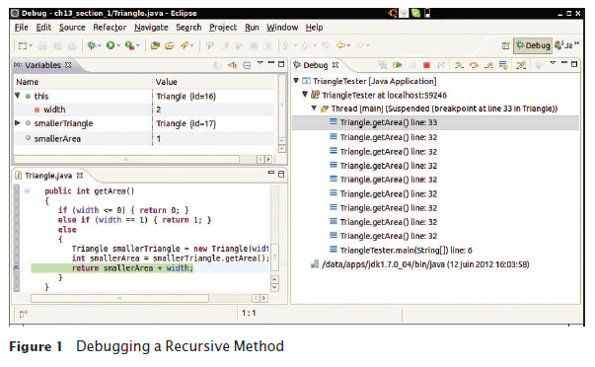
Tracing Through Recursive Methods
To debug recursive methods with a debugger, you need to be particularly careful, and watch the call stack to understand which nested call you currently are in.

Slide 50
Tracing Through Recursive Methods
Another means of debugging is the liberal use of System.out.println() statements

Slide 51
section_1/Triangle.java
21 /**
22 Computes the area of the triangle.
23 @return the area
24 */
25 public int getArea()
26 { System.out.println(“width=“+width);
27 if (width <= 0) { return 0; }
28 else if (width == 1) { return 1; }
29 else
30 {
31 Triangle smallerTriangle = new Triangle(width - 1);
32 int smallerArea = smallerTriangle.getArea();
33 return smallerArea + width;
34 }
35 }
36 }

Slide 52
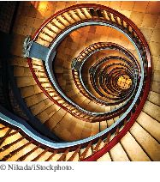
Thinking Recursively
Thinking recursively is easy if you can recognize a subtask that is similar to the original task.
Problem: test whether a sentence is a palindrome
Palindrome: a string that is equal to itself when you reverse all characters
A man, a plan, a canal – Panama!
Go hang a salami, I'm a lasagna hog
Madam, I'm Adam

Slide 53
Implement isPalindrome Method: How To 13.1
public class Sentence
{
private String text;
/**
Constructs a sentence.
@param aText a string containing all characters of the sentence
*/
public Sentence(String aText)
{
text = aText;
}
/**
Tests whether this sentence is a palindrome.
@return true if this sentence is a palindrome, false otherwise
*/
public boolean isPalindrome()
{
. . .
}
}

Slide 54
Thinking Recursively: How To 13.1
1. Consider various ways to simplify inputs. Here are several possibilities:
Remove the first character.
Remove the last character.
Remove both the first and last characters.
Remove a character from the middle.
Cut the string into two halves.

Slide 55
Thinking Recursively: How To 13.1
2. Combine solutions with simpler inputs into a solution of the original problem.
Most promising simplification: Remove first and last characters “adam, I'm Ada”, is a palindrome too!
Thus, a word is a palindrome if
The first and last letters match, and
Word obtained by removing the first and last letters is a palindrome
What if first or last character is not a letter? Ignore it.
If the first and last characters are letters, check whether they match; if so, remove both and test shorter string
If last character isn't a letter, remove it and test shorter string
If first character isn't a letter, remove it and test shorter string

Slide 56
Thinking Recursively: How To 13.1
3. Find solutions to the simplest inputs.
Strings with two characters
No special case required; step two still applies
Strings with a single character
They are palindromes
The empty string
It is a palindrome

Slide 57
Thinking Recursively: How To 13.1
4. Implement the solution by combining the simple cases and the reduction step:
public boolean isPalindrome()
{
int length = text.length();
// Separate case for shortest strings.
if (length <= 1) { return true; }
// Get first and last characters, converted to lowercase.
char first = Character.toLowerCase(text.charAt(0));
char last = Character.toLowerCase(text.charAt(length - 1));
Continued

Slide 58
Thinking Recursively: How To 13.1
if (Character.isLetter(first) && Character.isLetter(last))
{
// Both are letters.
if (first == last)
{
// Remove both first and last character.
Sentence shorter =
new Sentence(text.substring(1, length - 1));
return shorter.isPalindrome();
}
else
{
return false;
}
}
Continued

Slide 59
Thinking Recursively: How To 13.1
else if (!Character.isLetter(last))
{
// Remove last character.
Sentence shorter = new Sentence(text.substring(0, length - 1));
return shorter.isPalindrome();
}
else
{
// Remove first character.
Sentence shorter = new Sentence(text.substring(1));
return shorter.isPalindrome();
}
}

Slide 60

Recursive Helper Methods
Sometimes, a task can be solved by handing it off to a recursive helper method.
Sometimes it is easier to find a recursive solution if you make a slight change to the original problem.
Consider the palindrome test of previous slide.
It is a bit inefficient to construct new Sentence objects in every step

Slide 61
Recursive Helper Methods
Rather than testing whether the sentence is a palindrome, check whether a substring is a palindrome:
/**
Tests whether a substring of the sentence is a palindrome.
@param start the index of the first character of the substring
@param end the index of the last character of the substring
@return true if the substring is a palindrome
*/
public boolean isPalindrome(int start, int end)

Slide 62
Recursive Helper Methods - isPalindrome
public boolean isPalindrome(int start, int end)
{
// Separate case for substrings of length 0 and 1.
if (start >= end) { return true; }
// Get first and last characters, converted to lowercase.
char first = Character.toLowerCase(text.charAt(start));
char last = Character.toLowerCase(text.charAt(end));
if (Character.isLetter(first) && Character.isLetter(last))
{
if (first == last)
{
// Test substring that doesn’t contain the matching letters.
return isPalindrome(start + 1, end - 1);
}
else
{
return false;
}
}
Continued

Slide 63
Recursive Helper Methods - isPalindrome
else if (!Character.isLetter(last))
{
// Test substring that doesn’t contain the last character.
return isPalindrome(start, end - 1);
}
else
{
// Test substring that doesn’t contain the first character.
return isPalindrome(start + 1, end);
}
}

Slide 64
Recursive Helper Methods
Provide a method to call the helper method with positions that test the entire string:
public boolean isPalindrome()
{
return isPalindrome(0, text.length() - 1);
}
This call is not recursive
The isPalindrome(String) method calls the helper method isPalindrome(String, int, int).
An example of overloading
The public will call isPalindrome(String) method.
isPalindrome(String, int, int) is the recursive helper method.

Slide 65
The Efficiency of Recursion: Fibonacci Sequence
Fibonacci sequence is a sequence of numbers defined by:
f₁ = 1 f₂ = 1 f_{n} = f_{n-1} + f_{n-2}
First ten terms: 1, 1, 2, 3, 5, 8, 13, 21, 34, 55

Slide 66
section_3/RecursiveFib.java
1 import java.util.Scanner;
2
3 /**
4 This program computes Fibonacci numbers using a recursive method.
5 */
6 public class RecursiveFib
7 {
8 public static void main(String[] args)
9 {
10 Scanner in = new Scanner(System.in);
11 System.out.print("Enter n: ");
12 int n = in.nextInt();
13
14 for (int i = 1; i <= n; i++)
15 {
16 long f = fib(i);
17 System.out.println("fib(" + i + ") = " + f);
18 }
19 }
20
Continued

Slide 67
section_3/RecursiveFib.java
21 /**
22 Computes a Fibonacci number.
23 @param n an integer
24 @return the nth Fibonacci number
25 */
26 public static long fib(int n)
27 {
28 if (n <= 2) { return 1; }
29 else { return fib(n - 1) + fib(n - 2); }
30 }
31 }
Program Run:
Enter n: 50
fib(1) = 1
fib(2) = 1
fib(3) = 2
fib(4) = 3
fib(5) = 5
fib(6) = 8
fib(7) = 13
. . .
fib(50) = 12586269025

Slide 68
The Efficiency of Recursion
Recursive implementation of fib is straightforward.
Watch the output closely as you run the test program.
First few calls to fib are quite fast.
For larger values, the program pauses an amazingly long time between outputs.
To find out the problem, lets insert trace messages.

Slide 69
section_3/RecursiveFibTracer.java
1 import java.util.Scanner;
2
3 /**
4 This program prints trace messages that show how often the
5 recursive method for computing Fibonacci numbers calls itself.
6 */
7 public class RecursiveFibTracer
8 {
9 public static void main(String[] args)
10 {
11 Scanner in = new Scanner(System.in);
12 System.out.print("Enter n: ");
13 int n = in.nextInt();
14
15 long f = fib(n);
16
17 System.out.println("fib(" + n + ") = " + f);
18 }
19
Continued

Slide 70
section_3/RecursiveFibTracer.java
20 /**
21 Computes a Fibonacci number.
22 @param n an integer
23 @return the nth Fibonacci number
24 */
25 public static long fib(int n)
26 {
27 System.out.println("Entering fib: n = " + n);
28 long f;
29 if (n <= 2) { f = 1; }
30 else { f = fib(n - 1) + fib(n - 2); }
31 System.out.println("Exiting fib: n = " + n
32 + " return value = " + f);
33 return f;
34 }
35 }
Program Run:
Enter n: 6
Entering fib: n = 6
Entering fib: n = 5
Entering fib: n = 4
Entering fib: n = 3
Entering fib: n = 2
Continued

Slide 71
section_3/RecursiveFibTracer.java
Exiting fib: n = 2 return value = 1
Entering fib: n = 1
Exiting fib: n = 1 return value = 1
Exiting fib: n = 3 return value = 2
Entering fib: n = 2
Exiting fib: n = 2 return value = 1
Exiting fib: n = 4 return value = 3
Entering fib: n = 3
Entering fib: n = 2
Exiting fib: n = 2 return value = 1
Entering fib: n = 1
Exiting fib: n = 1 return value = 1
Exiting fib: n = 3 return value = 2
Exiting fib: n = 5 return value = 5
Entering fib: n = 4
Entering fib: n = 3
Entering fib: n = 2
Exiting fib: n = 2 return value = 1
Entering fib: n = 1
Exiting fib: n = 1 return value = 1
Exiting fib: n = 3 return value = 2
Entering fib: n = 2
Exiting fib: n = 2 return value = 1
Exiting fib: n = 4 return value = 3
Exiting fib: n = 6 return value = 8
fib(6) = 8

Slide 72
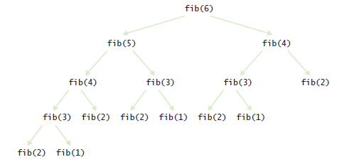
Call Tree for Computing fib(6)
Figure 2 Call Pattern of the Recursive fib Method

Slide 73
The Efficiency of Recursion
Method takes so long because it computes the same values over and over.
The computation of fib(6) calls fib(3) three times.
Imitate the pencil-and-paper process to avoid computing the values more than once.

Slide 74
section_3/LoopFib.java
1 import java.util.Scanner;
2
3 /**
4 This program computes Fibonacci numbers using an iterative method.
5 */
6 public class LoopFib
7 {
8 public static void main(String[] args)
9 {
10 Scanner in = new Scanner(System.in);
11 System.out.print("Enter n: ");
12 int n = in.nextInt();
13
14 for (int i = 1; i <= n; i++)
15 {
16 long f = fib(i);
17 System.out.println("fib(" + i + ") = " + f);
18 }
19 }
20
Continued

Slide 75
section_3/LoopFib.java
21 /**
22 Computes a Fibonacci number.
23 @param n an integer
24 @return the nth Fibonacci number
25 */
26 public static long fib(int n)
27 {
28 if (n <= 2) { return 1; }
29 else
30 {
31 long olderValue = 1;
32 long oldValue = 1;
33 long newValue = 1;
34 for (int i = 3; i <= n; i++)
35 {
36 newValue = oldValue + olderValue;
37 olderValue = oldValue;
38 oldValue = newValue;
39 }
40 return newValue;
41 }
42 }
43 }
Continued

Slide 76
section_3/LoopFib.java
Program Run:
Enter n: 50
fib(1) = 1
fib(2) = 1
fib(3) = 2
fib(4) = 3
fib(5) = 5
fib(6) = 8
fib(7) = 13
. . .
fib(50) = 12586269025

Slide 77

The Efficiency of Recursion
In most cases, the iterative and recursive approaches have comparable efficiency.
Occasionally, a recursive solution runs much slower than its iterative counterpart.
In most cases, the recursive solution is only slightly slower.
The iterative isPalindrome performs only slightly better than recursive solution.
Each recursive method call takes a certain amount of processor time

Slide 78
The Efficiency of Recursion
Smart compilers can avoid recursive method calls if they follow simple patterns.
Most compilers don't do that.
In many cases, a recursive solution is easier to understand and implement correctly than an iterative solution.

Slide 79
Iterative isPalindrome Method
public boolean isPalindrome()
{
int start = 0;
int end = text.length() - 1;
while (start < end)
{
char first = Character.toLowerCase(text.charAt(start));
char last = Character.toLowerCase(text.charAt(end);
if (Character.isLetter(first) && Character.isLetter(last))
{
// Both are letters.
if (first == last)
{
start++;
end--;
}
else
{
return false;
}
}
if (!Character.isLetter(last)) { end--; }
if (!Character.isLetter(first)) { start++; }
}
return true;
}

Slide 80

Permutations
Using recursion, you can find all arrangements of a set of objects.
Design a class that will list all permutations of a string. A permutation is a rearrangement of the letters.

Slide 81
Permutations
The string "eat" has six permutations:
"eat"
"eta"
"aet"
"ate"
"tea"
"tae”

Slide 82
Permutations
Problem: Generate all the permutations of "eat".
First generate all permutations that start with the letter 'e', then 'a' then 't'.
How do we generate the permutations that start with 'e'?
We need to know the permutations of the substring "at".
But that’s the same problem—to generate all permutations— with a simpler input
Prepend the letter 'e' to all the permutations you found of 'at'.
Do the same for 'a' and 't'.
Provide a special case for the simplest strings.
The simplest string is the empty string, which has a single permutation—itself.

Slide 83
section_4/Permutations.java
1 import java.util.ArrayList;
2
3 /**
4 This program computes permutations of a string.
5 */
6 public class Permutations
7 {
8 public static void main(String[] args)
9 {
10 for (String s : permutations("eat"))
11 {
12 System.out.println(s);
13 }
14 }
15
16 /**
17 Gets all permutations of a given word.
18 @param word the string to permute
19 @return a list of all permutations
20 */
21 public static ArrayList<String> permutations(String word)
22 {
23 ArrayList<String> result = new ArrayList<String>();
24
Continued

Slide 84
section_4/Permutations.java
25 // The empty string has a single permutation: itself
26 if (word.length() == 0)
27 {
28 result.add(word);
29 return result;
30 }
31 else
32 {
33 // Loop through all character positions
34 for (int i = 0; i < word.length(); i++)
35 {
36 // Form a shorter word by removing the ith character
37 String shorter = word.substring(0, i) + word.substring(i + 1);
38
39 // Generate all permutations of the simpler word
40 ArrayList<String> shorterPermutations = permutations(shorter);
41
42 // Add the removed character to the front of
43 // each permutation of the simpler word,
44 for (String s : shorterPermutations)
45 {
46 result.add(word.charAt(i) + s);
47 }
48 }
49 // Return all permutations
50 return result;
51 }
52 }
53 }
54
Continued

Slide 85
section_4/Permutations.java
Program Run:
eat
eta
aet
ate
tea
tae

Slide 86
Mutual Recursions
Problem: to compute the value of arithmetic expressions such as:
3 + 4 * 5 (3 + 4) * 5 1 - (2 - (3 - (4 - 5)))
Computing expression is complicated
* and / bind more strongly than + and -
Parentheses can be used to group subexpressions

Slide 87
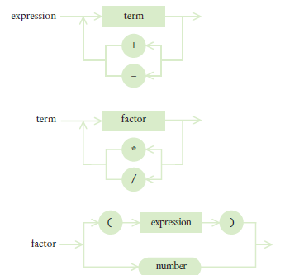
Syntax Diagrams for Evaluating an Expression
Figure 3

Slide 88
Mutual Recursions
An expression can broken down into a sequence of terms, separated by + or -.
Each term is broken down into a sequence of factors, separated by * or /.
Each factor is either a parenthesized expression or a number.
The syntax trees represent which operations should be carried out first.

Slide 89
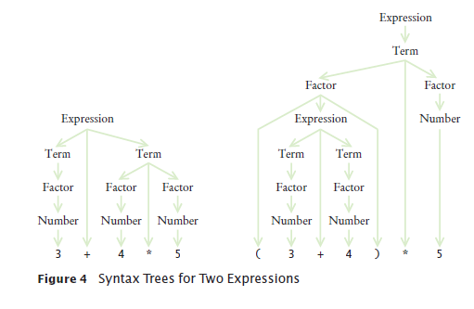
Syntax Tree for Two Expressions

Slide 90
Mutually Recursive Methods
In a mutual recursion, a set of cooperating methods calls each other repeatedly.
To compute the value of an expression, implement 3 methods that call each other recursively:
getExpressionValue
getTermValue
getFactorValue

Slide 91
The getExpressionValue Method
public int getExpressionValue()
{
int value = getTermValue();
boolean done = false;
while (!done)
{
String next = tokenizer.peekToken();
if ("+".equals(next) || "-".equals(next))
{
tokenizer.nextToken(); // Discard "+" or "-"
int value2 = getTermValue();
if ("+".equals(next)) value = value + value2;
else value = value - value2;
}
else
{
done = true;
}
}
return value;
}

Slide 92
The getTermValue Method
The getTermValue method calls getFactorValue in the same way, multiplying or dividing the factor values.

Slide 93
The getFactorValue Method
public int getFactorValue()
{
int value;
String next = tokenizer.peekToken();
if ("(".equals(next))
{
tokenizer.nextToken(); // Discard "("
value = getExpressionValue();
tokenizer.nextToken(); // Discard ")"
}
else
{
value = Integer.parseInt(tokenizer.nextToken());
}
return value;
}

Slide 94
Using Mutual Recursions
To see the mutual recursion clearly, trace through the expression (3+4)*5:
getExpressionValue calls getTermValue
getTermValue calls getFactorValue
getFactorValue consumes the ( input
getFactorValue calls getExpressionValue
getExpressionValue returns eventually with the value of 7, having consumed 3 + 4. This is the recursive call.
getFactorValue consumes the ) input
getFactorValue returns 7
getTermValue consumes the inputs * and 5 and returns 35
getExpressionValue returns 35
Recursion terminates when all the tokens of the input string are consumed.

Slide 95
section_5/Evaluator.java
1 /**
2 A class that can compute the value of an arithmetic expression.
3 */
4 public class Evaluator
5 {
6 private ExpressionTokenizer tokenizer;
7
8 /**
9 Constructs an evaluator.
10 @param anExpression a string containing the expression
11 to be evaluated
12 */
13 public Evaluator(String anExpression)
14 {
15 tokenizer = new ExpressionTokenizer(anExpression);
16 }
17
Continued

Slide 96
section_5/Evaluator.java
18 /**
19 Evaluates the expression.
20 @return the value of the expression.
21 */
22 public int getExpressionValue()
23 {
24 int value = getTermValue();
25 boolean done = false;
26 while (!done)
27 {
28 String next = tokenizer.peekToken();
29 if ("+".equals(next) || "-".equals(next))
30 {
31 tokenizer.nextToken(); // Discard "+" or "-"
32 int value2 = getTermValue();
33 if ("+".equals(next)) { value = value + value2; }
34 else { value = value - value2; }
35 }
36 else
37 {
38 done = true;
39 }
40 }
41 return value;
42 }
43
Continued

Slide 97
section_5/Evaluator.java
44 /**
45 Evaluates the next term found in the expression.
46 @return the value of the term
47 */
48 public int getTermValue()
49 {
50 int value = getFactorValue();
51 boolean done = false;
52 while (!done)
53 {
54 String next = tokenizer.peekToken();
55 if ("*".equals(next) || "/".equals(next))
56 {
57 tokenizer.nextToken();
58 int value2 = getFactorValue();
59 if ("*".equals(next)) { value = value * value2; }
60 else { value = value / value2; }
61 }
62 else
63 {
64 done = true;
65 }
66 }
67 return value;
68 }
69
Continued

Slide 98
section_5/Evaluator.java
70 /**
71 Evaluates the next factor found in the expression.
72 @return the value of the factor
73 */
74 public int getFactorValue()
75 {
76 int value;
77 String next = tokenizer.peekToken();
78 if ("(".equals(next))
79 {
80 tokenizer.nextToken(); // Discard "("
81 value = getExpressionValue();
82 tokenizer.nextToken(); // Discard ")"
83 }
84 else
85 {
86 value = Integer.parseInt(tokenizer.nextToken());
87 }
88 return value;
89 }
90 }

Slide 99
section_5/ExpressionTokenizer.java
1 /**
2 This class breaks up a string describing an expression
3 into tokens: numbers, parentheses, and operators.
4 */
5 public class ExpressionTokenizer
6 {
7 private String input;
8 private int start; // The start of the current token
9 private int end; // The position after the end of the current token
10
11 /**
12 Constructs a tokenizer.
13 @param anInput the string to tokenize
14 */
15 public ExpressionTokenizer(String anInput)
16 {
17 input = anInput;
18 start = 0;
19 end = 0;
20 nextToken(); // Find the first token
21 }
22
23 /**
24 Peeks at the next token without consuming it.
25 @return the next token or null if there are no more tokens
26 */
27 public String peekToken()
28 {
29 if (start >= input.length()) { return null; }
30 else { return input.substring(start, end); }
31 }
32
Continued

Slide 100
section_5/ExpressionTokenizer.java
33 /**
34 Gets the next token and moves the tokenizer to the following token.
35 @return the next token or null if there are no more tokens
36 */
37 public String nextToken()
38 {
39 String r = peekToken();
40 start = end;
41 if (start >= input.length()) { return r; }
42 if (Character.isDigit(input.charAt(start)))
43 {
44 end = start + 1;
45 while (end < input.length()
46 && Character.isDigit(input.charAt(end)))
47 {
48 end++;
49 }
50 }
51 else
52 {
53 end = start + 1;
54 }
55 return r;
56 }
57 }

Slide 101
section5/ExpressionCalculator.java
1 import java.util.Scanner;
2
3 /**
4 This program calculates the value of an expression
5 consisting of numbers, arithmetic operators, and parentheses.
6 */
7 public class ExpressionCalculator
8 {
9 public static void main(String[] args)
10 {
11 Scanner in = new Scanner(System.in);
12 System.out.print("Enter an expression: ");
13 String input = in.nextLine();
14 Evaluator e = new Evaluator(input);
15 int value = e.getExpressionValue();
16 System.out.println(input + "=" + value);
17 }
18 }
Program Run:
Enter an expression: 3+4*5
3+4*5=23

Slide 102
Backtracking
Backtracking is a problem solving technique that builds up partial solutions that get increasingly closer to the goal.
If a partial solution cannot be completed, one abandons it
And returns to examining the other candidates.
Characteristic properties needed to use backtracking for a problem.
A procedure to examine a partial solution and determine whether to
Accept it as an actual solution.
Abandon it (either because it violates some rules or because it is clear that it can never lead to a valid solution).
Continue extending it.
A procedure to extend a partial solution, generating one or more solutions that come closer to the goal.

Slide 103

Backtracking
In a backtracking algorithm, one explores all paths towards a solution. When one path is a dead end, one needs to backtrack and try another choice.

Slide 104
Backtracking
Backtracking can then be expressed with the following recursive algorithm:
Solve(partialSolution)
Examine(partialSolution).
If accepted
Add partialSolution to the list of solutions.
Else if continuing
For each p in extend(partialSolution)
Solve(p).

Slide 105
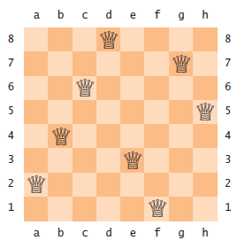
Backtracking - Eight Queens Problem
The Problem: position eight queens on a chess board so that none of them attacks another according to the rules of chess.
There are no two queens on the same row, column, or diagonal
A Solution to the Eight Queens Problem:

Slide 106
Backtracking - Eight Queens Problem
To examine a partial solution:
If two queens attack each other, reject it.
Otherwise, if it has eight queens, accept it.
Otherwise, continue.
To extend a partial solution:
Add another queen on an empty square
For efficiency, place first queen in row 1, the next in row 2, and so on

Slide 107
Backtracking
Provide a class PartialSolution
that collects the queens in a partial solution,
and that has methods to examine and extend the solution
public class PartialSolution
{
private Queen[] queens;
public int examine() { . . . }
public PartialSolution[] extend() { . . . }
}

Slide 108
Backtracking
The examine method simply checks whether two queens attack each other:
public int examine()
{
for (int i = 0; i < queens.length; i++)
{
for (int j = i + 1; j <queens.length; j++)
{
if (queens[i].attacks(queens[j])) { return ABANDON; }
}
}
if (queens.length == NQUEENS) { return ACCEPT; }
else { return CONTINUE; }
}

Slide 109
Backtracking
The extend method takes a given solution
And makes eight copies of it.
Each copy gets a new queen in a different column.

Slide 110
Backtracking
public PartialSolution[] extend()
{
// Generate a new solution for each column
PartialSolution[] result = new PartialSolution[NQUEENS];
for (int i = 0; i < result.length; i++)
{
int size = queens.length;
// The new solution has one more row than this one
result[i] = new PartialSolution(size + 1);
// Copy this solution into the new one
for (int j = 0; j < size; j++)
{
result[i].queens[j] = queens[j];
}
// Append the new queen into the ith column
result[i].queens[size] = new Queen(size, i);
}
return result;
}

Slide 111
Backtracking
To determine if two queens attack each other diagonally
Compute the slope.
If it ±1 the queens attack each other diagonally?
Just check:
|row₂ - row₁| = |column₂ - column₁|

Slide 112
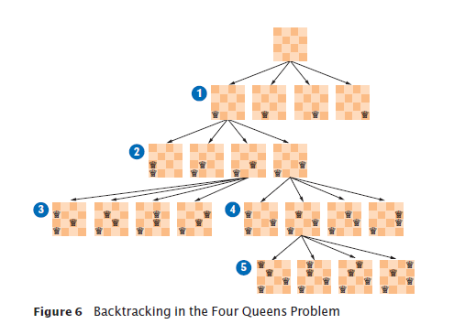
Backtracking
Backtracking in the Four Queens Problem

Slide 113
section_6/PartialSolution.java
1 import java.util.Arrays;
2
3 /**
4 A partial solution to the eight queens puzzle.
5 */
6 public class PartialSolution
7 {
8 private Queen[] queens;
9 private static final int NQUEENS = 8;
10
11 public static final int ACCEPT = 1;
12 public static final int ABANDON = 2;
13 public static final int CONTINUE = 3;
14
15 /**
16 Constructs a partial solution of a given size.
17 @param size the size
18 */
19 public PartialSolution(int size)
20 {
21 queens = new Queen[size];
22 }
23
Continued

Slide 114
section_6/PartialSolution.java
24 /**
25 Examines a partial solution.
26 @return one of ACCEPT, ABANDON, CONTINUE
27 */
28 public int examine()
29 {
30 for (int i = 0; i < queens.length; i++)
31 {
32 for (int j = i + 1; j < queens.length; j++)
33 {
34 if (queens[i].attacks(queens[j])) { return ABANDON; }
35 }
36 }
37 if (queens.length == NQUEENS) { return ACCEPT; }
38 else { return CONTINUE; }
39 }
40
Continued

Slide 115
section_6/PartialSolution.java
41 /**
42 Yields all extensions of this partial solution.
43 @return an array of partial solutions that extend this solution.
44 */
45 public PartialSolution[] extend()
46 {
47 // Generate a new solution for each column
48 PartialSolution[] result = new PartialSolution[NQUEENS];
49 for (int i = 0; i < result.length; i++)
50 {
51 int size = queens.length;
52
53 // The new solution has one more row than this one
54 result[i] = new PartialSolution(size + 1);
55
56 // Copy this solution into the new one
57 for (int j = 0; j < size; j++)
58 {
59 result[i].queens[j] = queens[j];
60 }
61
62 // Append the new queen into the ith column
63 result[i].queens[size] = new Queen(size, i);
64 }
65 return result;
66 }
67
68 public String toString() { return Arrays.toString(queens); }
69 }
70

Slide 116
section_6/Queen.java
1 /**
2 A queen in the eight queens problem.
3 */
4 public class Queen
5 {
6 private int row;
7 private int column;
8
9 /**
10 Constructs a queen at a given position.
11 @param r the row
12 @param c the column
13 */
14 public Queen(int r, int c)
15 {
16 row = r;
17 column = c;
18 }
19
Continued

Slide 117
section_6/Queen.java
20 /**
21 Checks whether this queen attacks another.
22 @param other the other queen
23 @return true if this and the other queen are in the same
24 row, column, or diagonal.
25 */
26 public boolean attacks(Queen other)
27 {
28 return row == other.row
29 || column == other.column
30 || Math.abs(row - other.row) == Math.abs(column - other.column);
31 }
32
33 public String toString()
34 {
35 return "" + "abcdefgh".charAt(column) + (row + 1) ;
36 }
37 }

Slide 118
section_6/EightQueens.java
1 /**
2 This class solves the eight queens problem using backtracking.
3 */
4 public class EightQueens
5 {
6 public static void main(String[] args)
7 {
8 solve(new PartialSolution(0));
9 }
10
11 /**
12 Prints all solutions to the problem that can be extended from
13 a given partial solution.
14 @param sol the partial solution
15 */
16 public static void solve(PartialSolution sol)
17 {
18 int exam = sol.examine();
19 if (exam == PartialSolution.ACCEPT)
20 {
21 System.out.println(sol);
22 }
23 else if (exam == PartialSolution.CONTINUE)
24 {
25 for (PartialSolution p : sol.extend())
26 {
27 solve(p);
28 }
29 }
30 }
31 }
32
Continued

Slide 119
section_6/EightQueens.java
Program Run:
[a1, e2, h3, f4, c5, g6, b7, d8]
[a1, f2, h3, c4, g5, d6, b7, e8]
[a1, g2, d3, f4, h5, b6, e7, c8]
. . .
[f1, a2, e3, b4, h5, c6, g7, d8]
. . .
[h1, c2, a3, f4, b5, e6, g7, d8]
[h1, d2, a3, c4, f5, b6, g7, e8]
(92 solutions)

Slide 120
Towers of Hanoi
History
The Tower of Hanoi is a puzzle that was invented by the French mathematician Eduoard Lucas in 1883. The puzzle was created out of an old Hindu legend. The story tells of a Hindu temple at the center of the world where priests were given a stack of 64 golden disks of decreasing size. The disks were stacked on one of three towers. The priests were to transfer the stack of disks from the starting tower to another. The priests, tasked by God to complete the game, were to work diligently. It was said that when they completed their task, the temple would crumble to dust and the world would come to an end.

Slide 121
Towers of Hanoi
The Math
The Tower of Hanoi is often used in Computer Science courses to teach algorithms and recursion. Ultimately, one can write a program that efficiently will complete the puzzle for any number of discs, n. In simple terms, however, the minimum number of moves necessary to complete the puzzle is 2^{n-1}.
Therefore, assuming one move per second, it would take the priests in the Hindu legend over 580 billion years to complete their task.

Slide 122
The Towers of Hanoi
The Towers of Hanoi is a puzzle made up of three vertical pegs and several disks that slide onto the pegs
The disks are of varying size, initially placed on one peg with the largest disk on the bottom and increasingly smaller disks on top
The goal is to move all of the disks from one peg to another following these rules:
Only one disk can be moved at a time
A disk cannot be placed on top of a smaller disk
All disks must be on some peg (except for the one in transit)

Slide 123
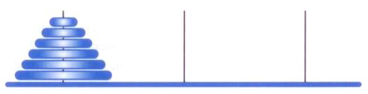
Towers of Hanoi
The initial state of the Towers of Hanoi puzzle:

Slide 124
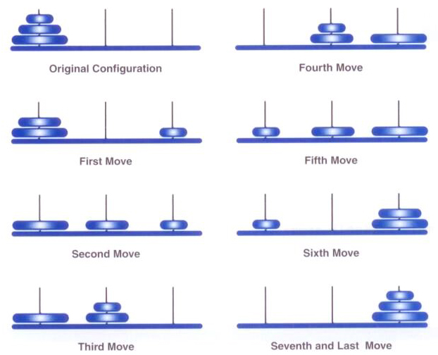
Towers of Hanoi
A solution to the three-disk Towers of Hanoi puzzle:

Slide 125
Towers of Hanoi
A solution to ToH can be expressed recursively
To move N disks from the original peg to the destination peg:
Move the topmost N-1 disks from the original peg to the extra peg
Move the largest disk from the original peg to the destination peg
Move the N-1 disks from the extra peg to the destination peg
The base case occurs when a peg contains only one disk

Slide 126
Towers of Hanoi
The number of moves increases exponentially as the number of disks increases
The recursive solution is simple and elegant to express and program, but is very inefficient
However, an iterative solution to this problem is much more complex to define and program

Slide 127
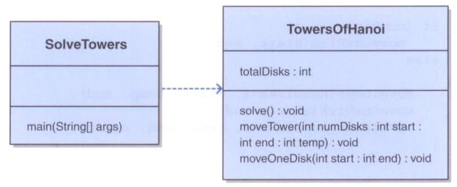
Towers of Hanoi

Slide 128
/**
* SolveTowers uses recursion to solve the Towers of Hanoi puzzle.
*
* @author Lewis and Chase
* @version 4.0
*/
public class SolveTowers
{
/**
* Creates a TowersOfHanoi puzzle and solves it.
*/
public static void main(String[] args)
{
TowersOfHanoi towers = new TowersOfHanoi(4);
towers.solve();
}
}

Slide 129
/**
* TowersOfHanoi represents the classic Towers of Hanoi puzzle.
* @author Lewis and Chase
* @version 4.0
*/
public class TowersOfHanoi {
private int totalDisks;
/**
* Sets up the puzzle with the specified number of disks.
* @param disks the number of disks
*/
public TowersOfHanoi(int disks) {
totalDisks = disks;
}
/**
* Performs the initial call to moveTower to solve the puzzle.
* Moves the disks from tower 1 to tower 3 using tower 2.
*/
public void solve() {
moveTower(totalDisks, 1, 3, 2);
}

Slide 130
/**
* Moves the specified number of disks from one tower to another
* by moving a subtower of n-1 disks out of the way, moving one
* disk, then moving the subtower back. Base case of 1 disk.
*
* @param numDisks the number of disks to move
* @param start the starting tower
* @param end the ending tower
* @param temp the temporary tower
*/
private void moveTower(int numDisks, int start, int end, int temp)
{
if (numDisks == 1)
moveOneDisk(start, end);
else
{
moveTower(numDisks-1, start, temp, end);
moveOneDisk(start, end);
moveTower(numDisks-1, temp, end, start);
}
}

Slide 131
/**
* Prints instructions to move one disk from the specified start
* tower to the specified end tower.
*
* @param start the starting tower
* @param end the ending tower
*/
private void moveOneDisk(int start, int end)
{
System.out.println("Move one disk from " + start + " to " + end);
}
}

